Slide 1


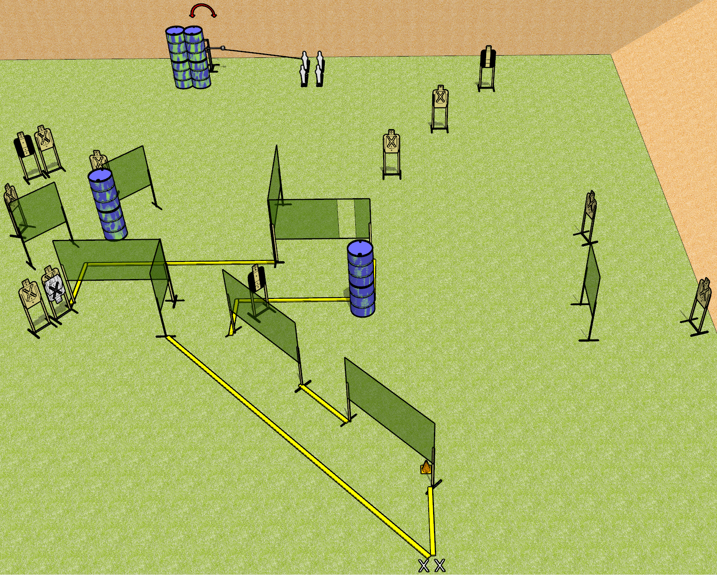
 | Dothan Gun Club – USPSA Match Underbite Course Designer : Drew Coleman
START POSITION : Standing with both feet on X’s, wrists below belt
GUN READY CONDITION : Pistol loaded and holstered. PCC loaded, held with both hands, shouldered, safety on, pointed at orange cone. |  | SCORING: Comstock, 30 rounds TARGETS: 13 paper, 4 Steel SCORED HITS: Best 2 on paper, steel until down START-STOP: Audible, last shot RULES:
STAGE PROCEDURE: Engage targets as they become available from within the fault lines.

Slide 2
Underbite
Written Stage Briefing
Underbite is a 30 round, 150 point, Comstock field course. There are thirteen USPSA targets and four mini poppers. The best two hits on paper will score, and steel must fall to score.
The back left mini popper activates the swinger. Please check the activator prior to walkthrough and set it the same way for each shooter.
Handgun start position is standing with both feet on X’s, wrists below belt. Handgun is loaded and holstered.
PCC start position is standing with both feet on X’s, muzzle pointed at orange cone. Loaded carbine is held with both hands, safety on, shouldered.
On start signal engage targets as they become available from within the shooting area.

